Slide 1
JavaScript – Continued..
Instructor: Manu Peethambar
E-mail: cm13055@umbc.edu
Telegram handle: @manupeethambar888
Slides: https://github.com/manupeethambar888/webdev

Slide 2
JavaScript Objects
JavaScript objects are containers for named values called properties or methods.
https://www.w3schools.com/js/js_objects.asp
JavaScript Scope
Scope determines the accessibility (visibility) of variables.
https://www.w3schools.com/js/js_scope.asp
JavaScript Events
HTML events are "things" that happen to HTML elements, JavaScript can "react" on these events.
https://www.w3schools.com/js/js_events.asp

Slide 3
JavaScript Strings
JavaScript strings are used for storing and manipulating text.
https://www.w3schools.com/js/js_strings.asp
JavaScript String Methods
String methods help you to work with strings.
https://www.w3schools.com/js/js_string_methods.asp
JavaScript Numbers
https://www.w3schools.com/js/js_numbers.asp

Slide 4
JavaScript Number Methods
Number methods help you work with numbers.
https://www.w3schools.com/js/js_number_methods.asp
JavaScript Arrays
JavaScript arrays are used to store multiple values in a single variable.
https://www.w3schools.com/js/js_arrays.asp
JavaScript Array Methods
https://www.w3schools.com/js/js_array_methods.asp

Slide 5
Exam 2 – 7/13/2018 (Friday)
Study all slides on Cascading Style Sheets(CSS):
https://github.com/manupeethambar888/webdev
Practice all the concepts taught on www.w3schools.com try it editor.

Slide 6
Assignment 13 due – 7/13/2018
Create a sample html file.
Go to the next slide for the question.
Save this as “assignment13.html” in Homework folder in your GitHub repository “Assignments_yourname”.
Commit and push the changes to the repository.

Slide 7
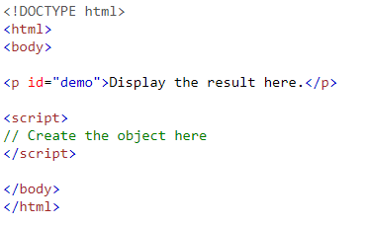
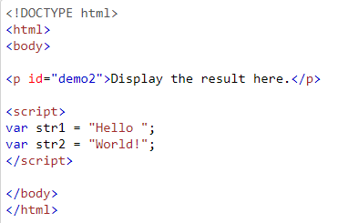
Assignment 13 due – 7/13/2018
Create an object called person with name = John, age = 50. Then, access the object to display "John is 50 years old".
Use the concat() method to join the two strings: str1 and str2.

